Slide 1
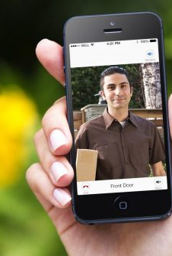
AI DOOR-MAN AI-Geeks
Ahmed Awad Albishri
Marajan Tutu
Syed Jawad Hussain Shah

Slide 2
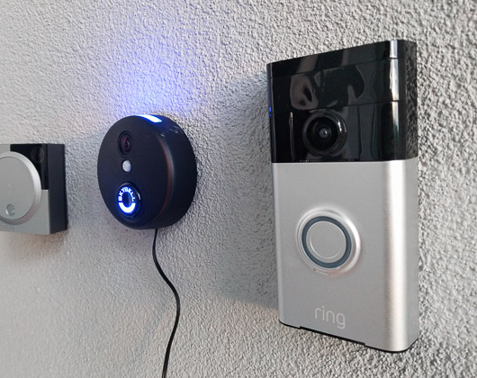
Goal
The goal is to make a smart door system that has following characteristics:
Ensure security by providing image surveillance
Interacts with user through a mobile app
Allow user to communicate with the person at the door
Provide User with a remote access

Slide 3
Approach
Camera and Ultrasonic sensors connected to node red
Node red operates on Raspberry pi
Once the motion is sensed, camera takes the picture and sends to android app with time stamp
The user can respond back with different texts that are changed into sound and speakers plays it to the person at the door
The user can also lock/unlock the door with the app

Slide 4
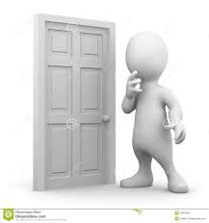
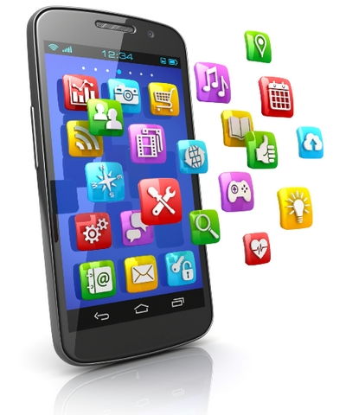
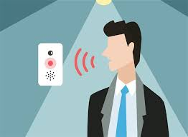

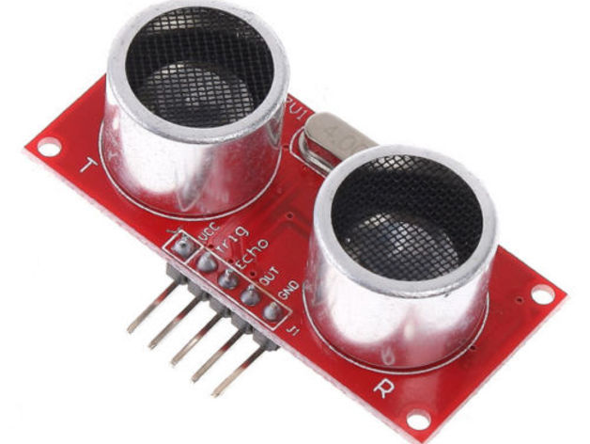
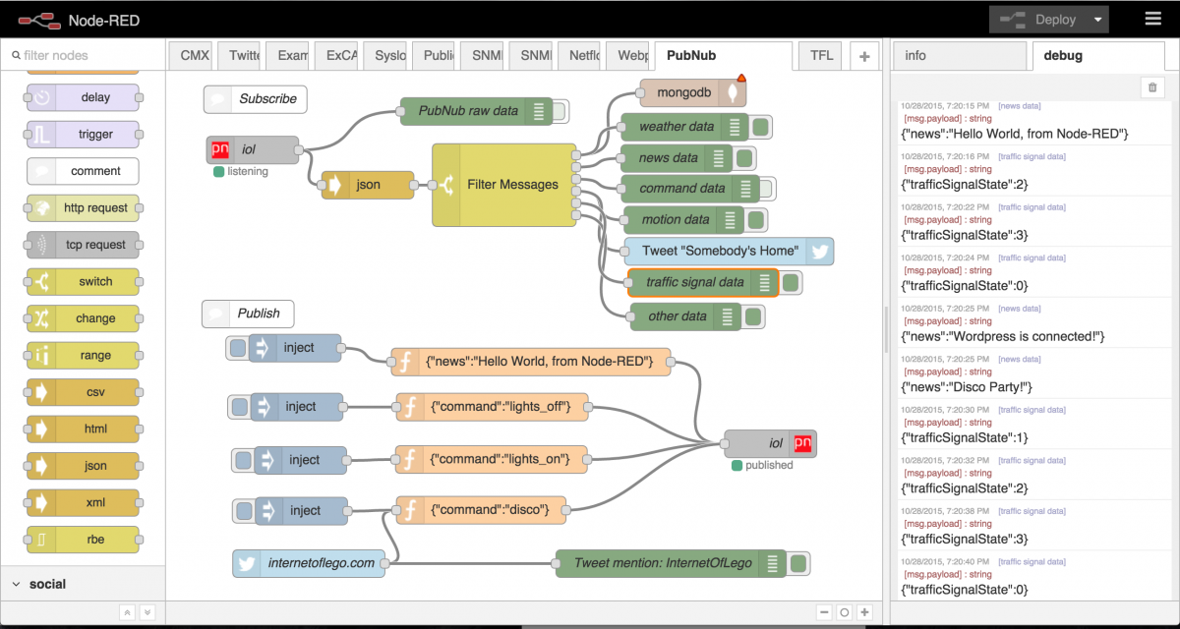
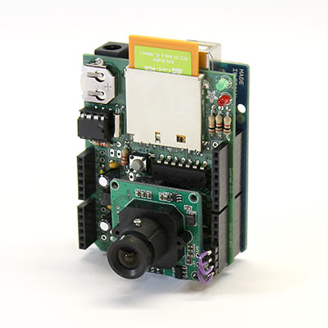

Architecture
Person at the door
1
Android app
6
Speaker at the door
7
Firebase Cloud
Motion Sensor
10
5
2
8
9
Raspberry PI
Camera
3
Node Red
4

Slide 5
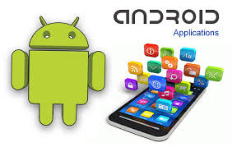
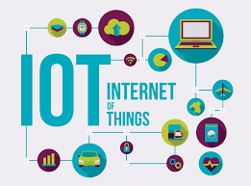


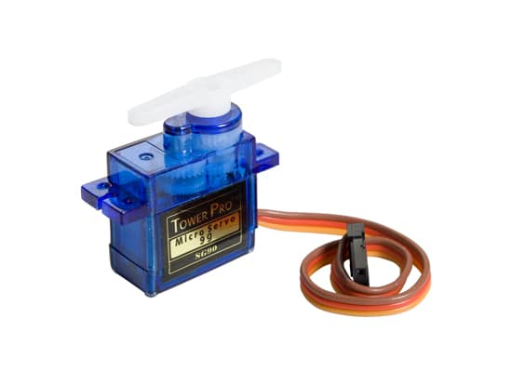
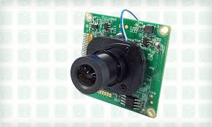



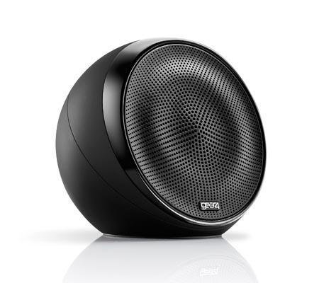
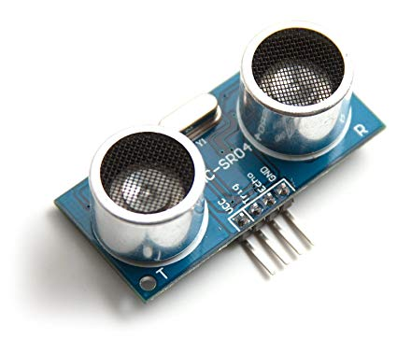
Technologies/ Tools used

Slide 6

Questions and comments

